Slide 1
CS 350 Research Project
Egemen İşcan
Barış Karaer
Ertan Ayanlar

Slide 2
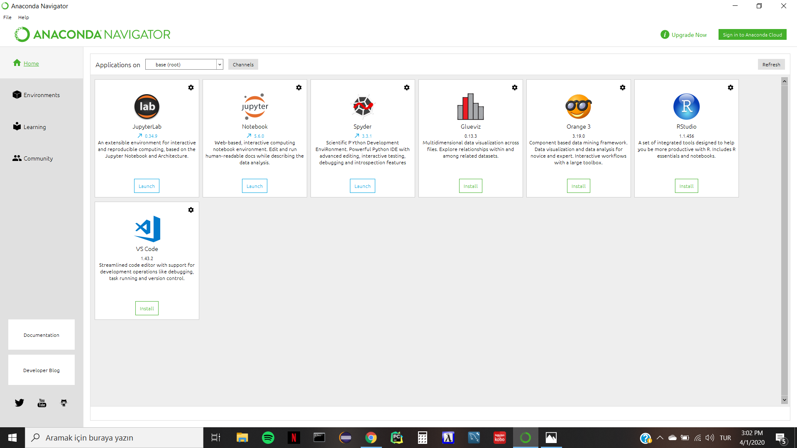
Software
All members of our team have the necessary software installed on their computers. We will be using PyCharm and Anaconda for Python 3 programming.
We will be importing libraries such as os and matplotlib.
We won’t need any other software for this project.

Slide 3
Background Research
https://www.youtube.com/watch?v=Z6BHlwgYeQA
In this video it explains how to list a directory and how we can sort files based on file size. We will use some tips that are given in this video. For example, to check the size of the files we will use this method (stat.ST_SIZE).
https://www.howtogeek.com/195262/hybrid-hard-drives-explained-why-you-might-want-one-instead-of-an-ssd/
In this article it compares the differences between SSD and hybrid drives. This will give us a more thorough understanding of the subject.

Slide 4
Background Research
https://www.youtube.com/watch?v=5QDf5gJki70
In this video it explains how we can count the fıles in a given directory.
https://stackoverflow.com/questions/1320731/count-number-of-files-with-certain-extension-in-python
This explains how to find the counts of number of files with certain extensions. We will be inspecting what kind of files can normally be seen in directories. Then we will be storing them in different variables. (exeFileCount, csvFileCount, pptxFileCount etc.)

Slide 5
Background Research
https://stackoverflow.com/questions/8858008/how-to-move-a-file-in-python
This link explains how to move files from one directory to another directory, which will be useful for the second part of our project.
https://realpython.com/working-with-files-in-python/
Also this link will be very helpful while working with files in python.

Slide 6
Work Plan
UNTIL THE END OF APRIL
Before making remarks about the hypothesis we will be implementing the code that counts the specific file sizes and logs the count of their sizes.
Making remarks about the hypothesis:
Are 90 % of the files smaller than 100 KB ?
Are 80 % of the files used in SSD ‘ s more than 100 MB ?
Making 4 graphs :
X Axis File Size (<1K,<10K,<100K,<1M,<10M,<100M,<1GB,>=1GB)
Y Axis: Count PDF (Probability Distribution Function) and Y Axis Count CDF (Cumulative Distribution Function)
X Axis File Size (<1K,<10K,<100K,<1M,<10M,<100M,<1GB,>=1GB)
Y Axis: Kbytes PDF (Probability Distribution Function) and Y Axis Kbytes CDF (Cumulative Distribution Function)

Slide 7
Work Plan
UNTIL THE END OF MAY
We will add a new feature to our program which enables us to store the previously compared files either in SSD or the hard disk.
Then we need to write a report which explains everything in detail what we will be doing as a group.

